Slide 1
Rigid Bodies: Equivalent Systems of Forces

Slide 2
Contents
Introduction
External and Internal Forces
Principle of Transmissibility: Equivalent Forces
Vector Products of Two Vectors
Moment of a Force About a Point
Varigon’s Theorem
Rectangular Components of the Moment of a Force
Sample Problem 3.1
Scalar Product of Two Vectors
Scalar Product of Two Vectors: Applications
Mixed Triple Product of Three Vectors
Moment of a Force About a Given Axis
Sample Problem 3.5
Moment of a Couple
Addition of Couples
Couples Can Be Represented By Vectors
Resolution of a Force Into a Force at O and a Couple
Sample Problem 3.6
Reduction of a System of Forces to and a One Force and One Couple
Further Reduction of a System of Forces
Sample Problem 3.8
Sample Problem 3.10
3 - <number>

Slide 3
Introduction
Treatment of a body as a single particle is not always possible. In general, the size of the body and the specific points of application of the forces must be considered.
Current chapter describes the effect of forces exerted on a rigid body and how to replace a given system of forces with a simpler equivalent system.
First, we need to learn some new statics concepts, including:
  moment of a force about a point
  moment of a force about an axis
  moment due to a couple
Any system of forces acting on a rigid body can be replaced by an equivalent system consisting of one force acting at a given point and one couple.
3 - <number>

Slide 4
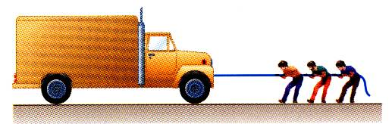
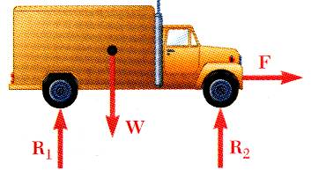
External and Internal Forces
Forces acting on rigid bodies are divided into two groups:
  External forces
  Internal forces
External forces are shown in a free body diagram.
Internal forces, such as the force between each wheel and the axel it is mounted on, are never shown on a free body diagram.
3 - <number>

Slide 5
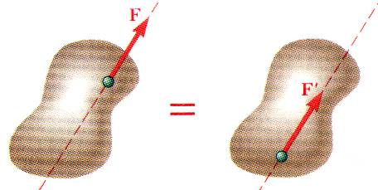
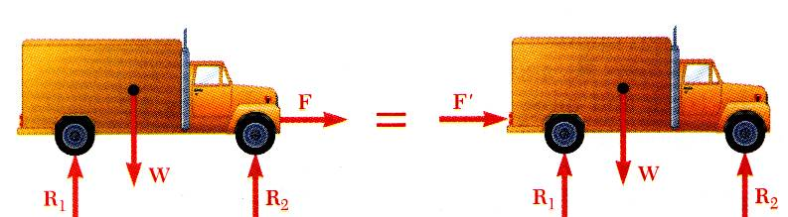
Principle of Transmissibility: Equivalent Forces
Principle of Transmissibility -
Conditions of equilibrium or motion are not affected by transmitting a force along its line of action.
NOTE: F and F’ are equivalent forces.
Moving the point of application of the force F to the rear bumper does not affect the motion or the other forces acting on the truck.
3 - <number>

Slide 6
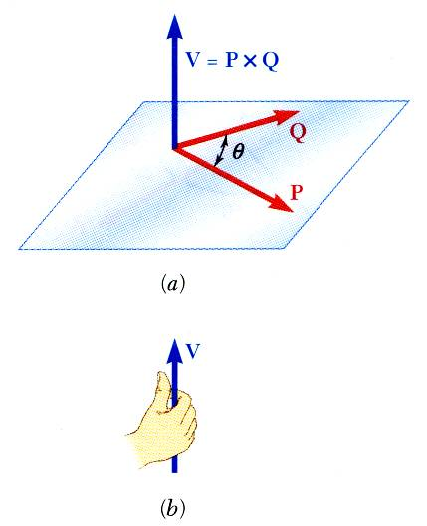




Vector Product of Two Vectors
Concept of the moment of a force about a point requires the understanding of the vector product or cross product.
Vector product of two vectors P and Q is defined as the vector V which satisfies the following conditions:
  Line of action of V is perpendicular to plane containing P and Q.
  Magnitude of V is
  Direction of V is obtained from the right-hand rule.
Vector products:
  are not commutative,
  are distributive,
  are not associative,
3 - <number>

Slide 7
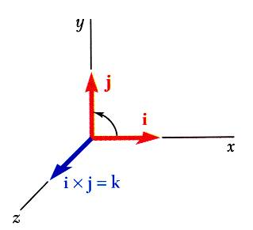
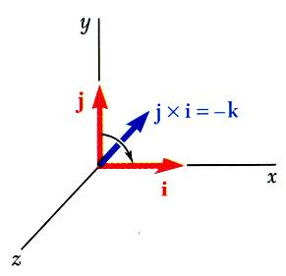
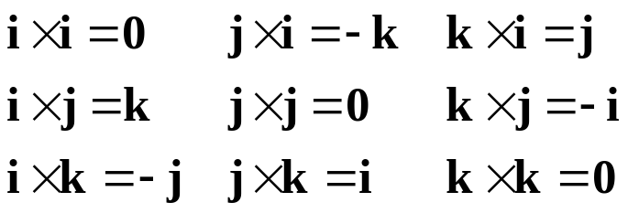
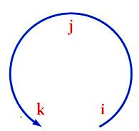

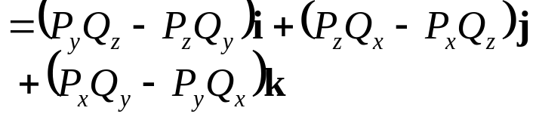
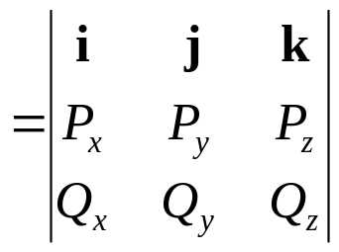
Vector Products: Rectangular Components
Vector products of Cartesian unit vectors,
Vector products in terms of rectangular coordinates
3 - <number>

Slide 8
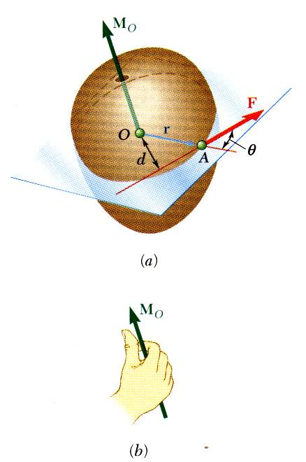


Moment of a Force About a Point
A force vector is defined by its magnitude and direction. Its effect on the rigid body also depends on its point of application.
The moment of F about O is defined as
The moment vector M_{O} is perpendicular to the plane containing O and the force F.
Magnitude of M_{O,} ,
measures the tendency of the force to cause rotation of the body about an axis along M_{O}. The sense of the moment may be determined by the right-hand rule.
Any force F’ that has the same magnitude and direction as F, is equivalent if it also has the same line of action and therefore, produces the same moment.
3 - <number>

Slide 9
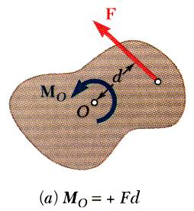
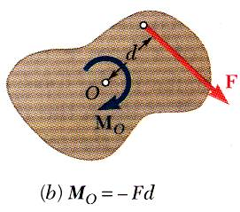
Moment of a Force About a Point
Two-dimensional structures have length and breadth but negligible depth and are subjected to forces contained only in the plane of the structure.
The plane of the structure contains the point O and the force F. M_{O}, the moment of the force about O, is perpendicular to the plane.
If the force tends to rotate the structure clockwise, the sense of the moment vector is out of the plane of the structure and the magnitude of the moment is positive.
If the force tends to rotate the structure counterclockwise, the sense of the moment vector is into the plane of the structure and the magnitude of the moment is negative.
3 - <number>

Slide 10
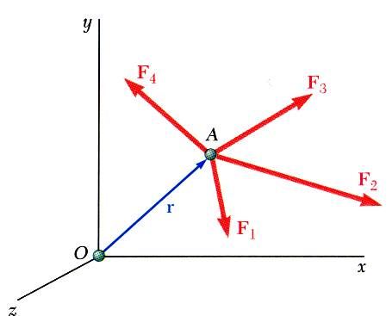
Varignon’s Theorem
The moment about a give point O of the resultant of several concurrent forces is equal to the sum of the moments of the various moments about the same point O.
Varignon’s Theorem makes it possible to replace the direct determination of the moment of a force F by the moments of two or more component forces of F.
3 - <number>

Slide 11
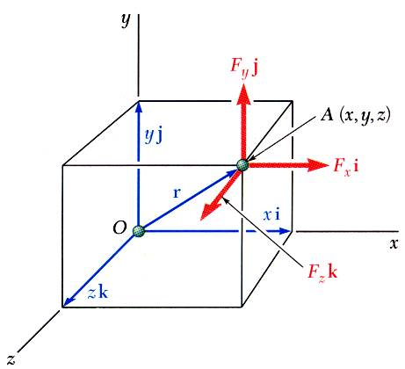
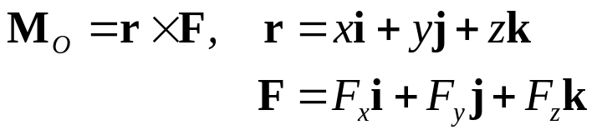
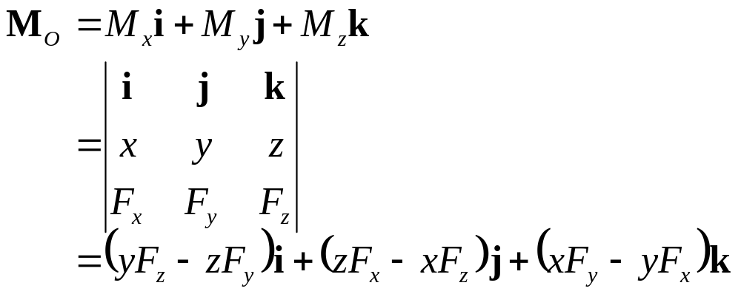
Rectangular Components of the Moment of a Force
The moment of F about O,
The components of M_{O} , M_{x}, M_{y}, and M_{z}, represent the moments about the x-, y- and z-axis, respectively.
3 - <number>

Slide 12
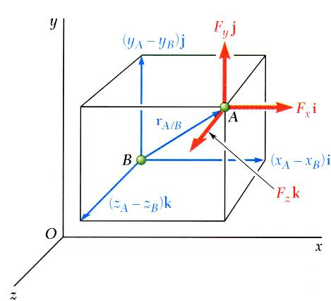

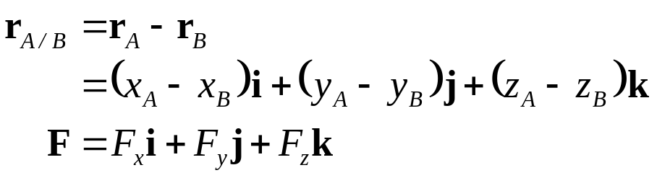
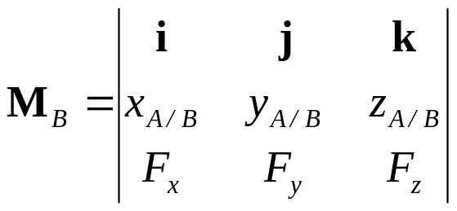
Rectangular Components of the Moment of a Force
The moment of F about B,
3 - <number>

Slide 13
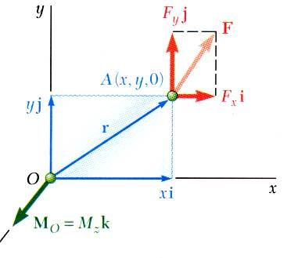
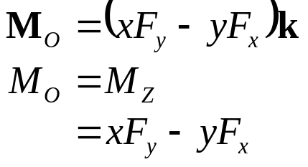
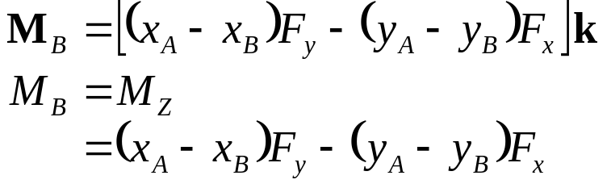
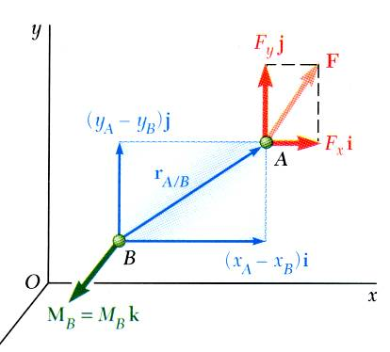
Rectangular Components of the Moment of a Force
For two-dimensional structures,
3 - <number>

Slide 14
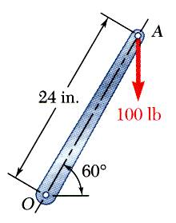
Sample Problem 3.1
A 500-N vertical force is applied to the end of a lever which is attached to a shaft (not shown) at O.
Determine:
the moment about O,
the horizontal force at A which creates the same moment,
the smallest force at A which produces the same moment,
the location for a 1200-N vertical force to produce the same moment,
whether any of the forces from b, c, and d is equivalent to the original force.
0.6 m
500 N
3 - <number>

Slide 15
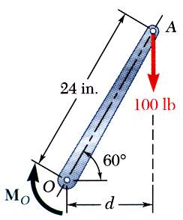
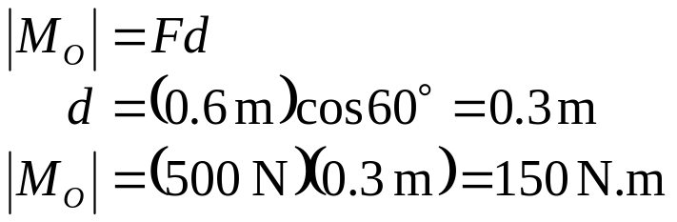

Sample Problem 3.1
a) Moment about O is equal to the product of the force and the perpendicular distance between the line of action of the force and O. Since the force tends to rotate the lever clockwise, the moment vector is into the plane of the paper which, by our sign convention, would be negative or counterclockwise.
0.6 m
500 N
3 - <number>

Slide 16
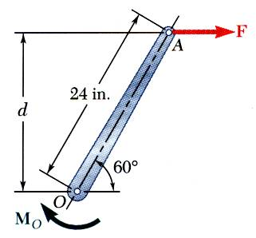
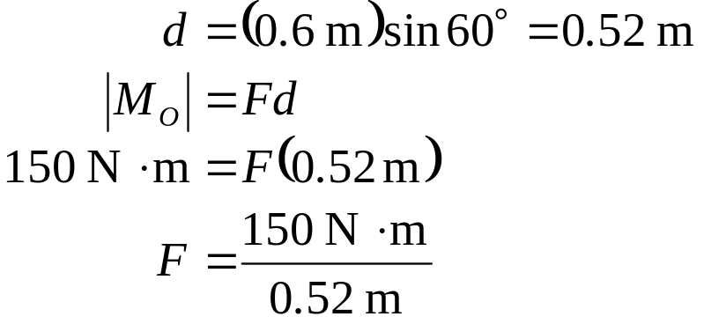

Sample Problem 3.1
b) Horizontal force at A that produces the same moment,
0.6 m
Why must the direction of this F be to the right?
3 - <number>

Slide 17
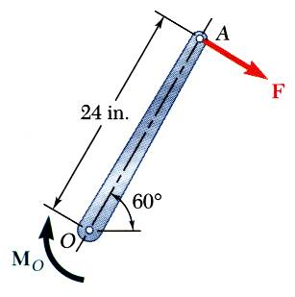
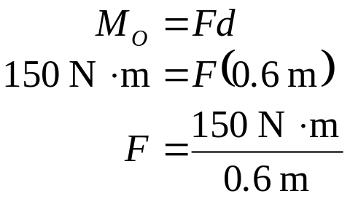

Sample Problem 3.1
F(min) ?
What is the smallest force at A which produces the same moment? Think about it and discuss with a neighbor.
0.6 m
c) The smallest force at A to produce the same moment occurs when the perpendicular distance is a maximum or when F is perpendicular to OA.
30º
3 - <number>

Slide 18
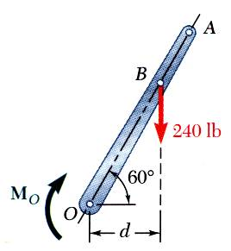
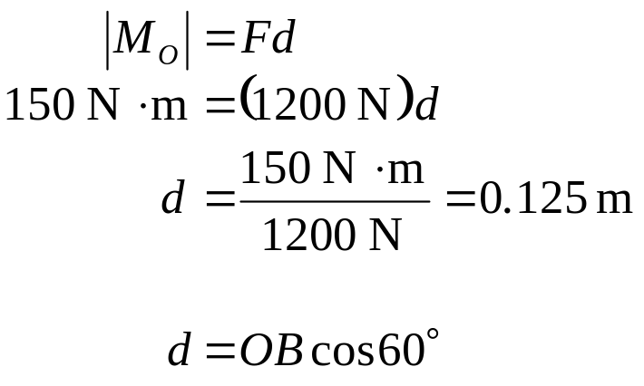

Sample Problem 3.1
d) To determine the point of application of a 1200 N force to produce the same moment,
1200 N
3 - <number>

Slide 19
Sample Problem 3.1
e) Although each of the forces in parts b), c), and d) produces the same moment as the 500 N force, none are of the same magnitude and sense, or on the same line of action. None of the forces is equivalent to the 1200 N force.
0.6 m
500 N
0.6 m
0.6 m
1200 N
3 - <number>

Slide 20
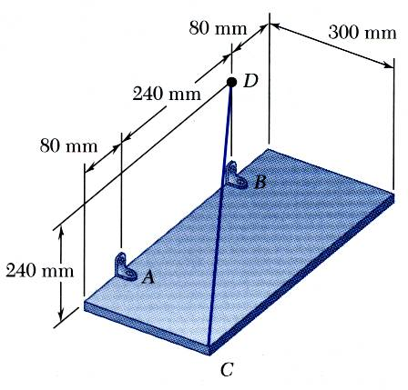

Sample Problem 3.4
Solution
How do you find the moment? What is the equation for this moment? Discuss this with a neighbor and describe in detail each variable in your equation, including (a) how you would write it, (b) what its units are, and (c) whether or not there are any alternative variables that could take its place.
The rectangular plate is supported by the brackets at A and B and by a wire CD. Knowing that the tension in the wire is 200 N, determine the moment about A of the force exerted by the wire at C.
The moment M_{A} of the force F exerted by the wire is obtained by evaluating the vector product,
3 - <number>

Slide 21
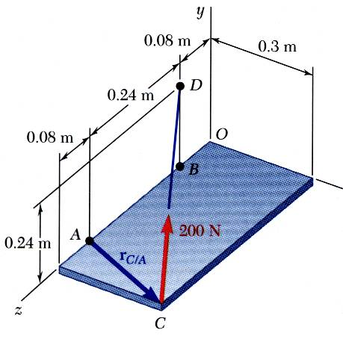

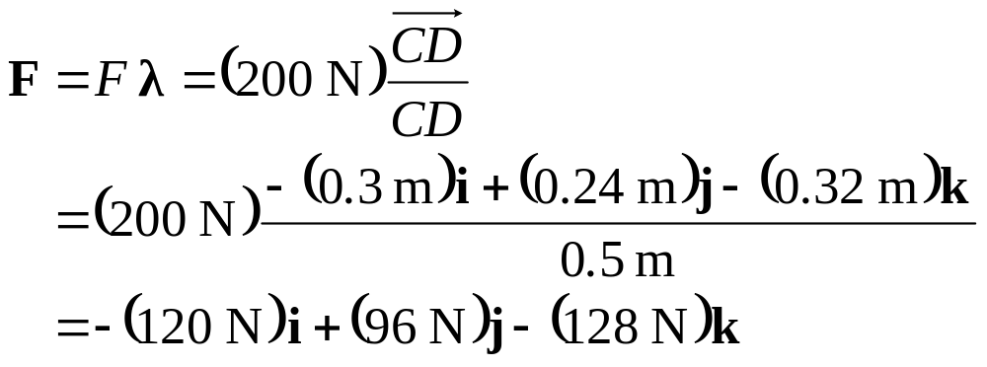
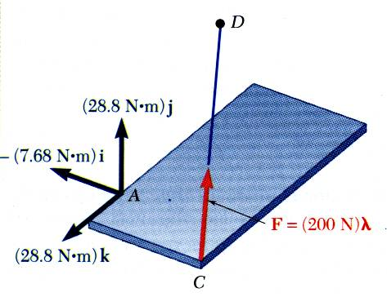
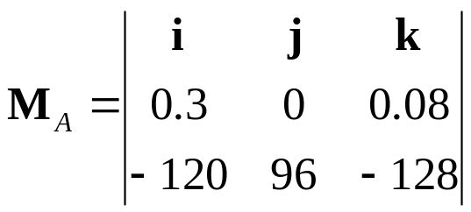
Sample Problem 3.4
SOLUTION:
3 - <number>

Slide 22
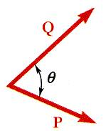




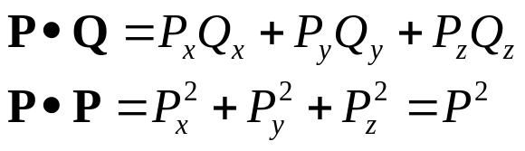
Scalar Product of Two Vectors
The scalar product or dot product between two vectors P and Q is defined as
Scalar products:
  are commutative,
  are distributive,
  are not associative,
Scalar products with Cartesian unit components,
3 - <number>

Slide 23
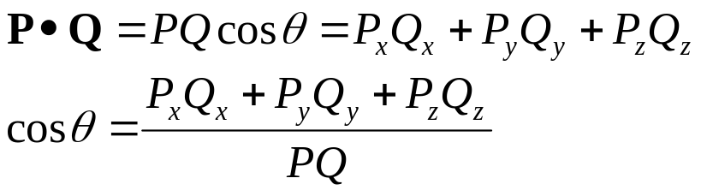
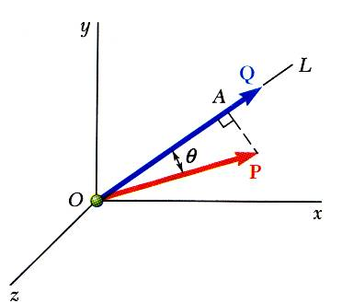
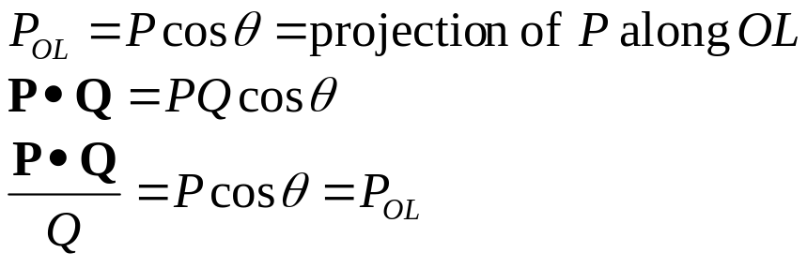
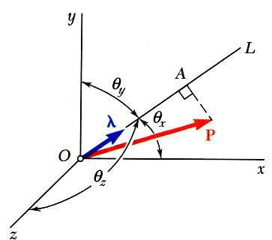
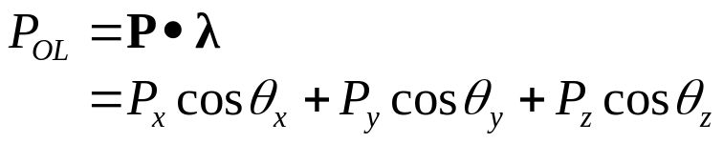
Scalar Product of Two Vectors: Applications
Angle between two vectors:
Projection of a vector on a given axis:
For an axis defined by a unit vector:
3 - <number>

Slide 24
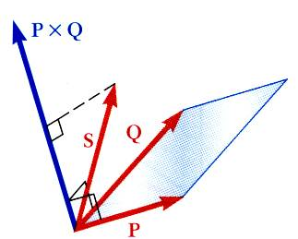

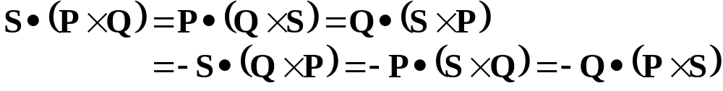
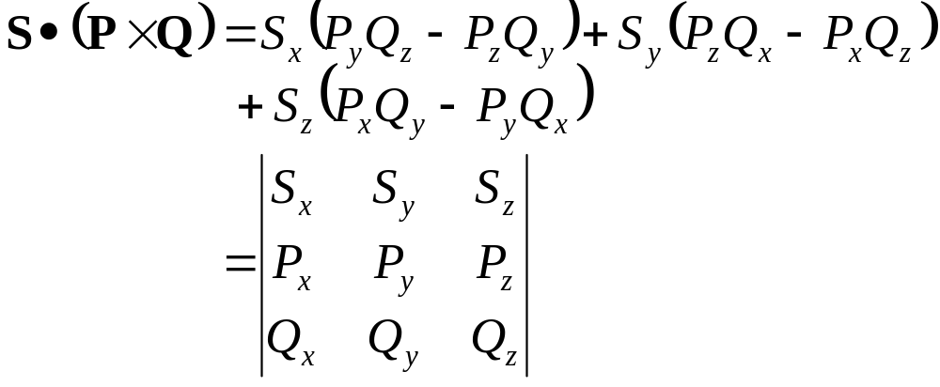
Mixed Triple Product of Three Vectors
Mixed triple product of three vectors,
The six mixed triple products formed from S, P, and Q have equal magnitudes but not the same sign,
Evaluating the mixed triple product,
3 - <number>

Slide 25
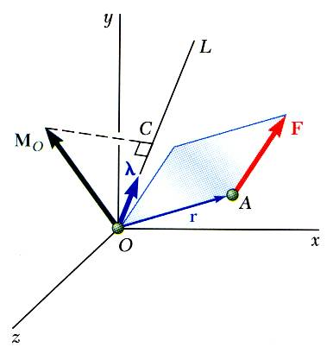


Moment of a Force About a Given Axis
Moment M_{O} of a force F applied at the point A about a point O,
Scalar moment M_{OL} about an axis OL is the projection of the moment vector M_{O} onto the axis,
Moments of F about the coordinate axes,
3 - <number>

Slide 26



Moment of a Force About a Given Axis
Moment of a force about an arbitrary axis,
The result is independent of the point B along the given axis. That is, the same result can be obtained using , for example.
3 - <number>

Slide 27

Sample Problem 3.5
A cube is acted on by a force P as shown. Determine the moment of P
about A,
about the edge AB and
about the diagonal AG of the cube.
Determine the perpendicular distance between AG and FC.
3 - <number>

Slide 28





Sample Problem 3.5
Moment of P about A,
List an alternative to the position vector r_{F/A}, and discuss your answer with a neighbor.
Moment of P about AB,
3 - <number>

Slide 29



Sample Problem 3.5
Moment of P about the diagonal AG,
What if, for λ, you had chosen r_{A/G} instead? How would that change the answer?
3 - <number>

Slide 30




Sample Problem 3.5
Perpendicular distance between AG and FC,
Therefore, P is perpendicular to AG.
3 - <number>

Slide 31




Moment of a Couple
Two forces F and -F having the same magnitude, parallel lines of action, and opposite sense are said to form a couple.
Moment of the couple,
The moment vector of the couple is independent of the choice of the origin of the coordinate axes, i.e., it is a free vector that can be applied at any point with the same effect.
3 - <number>

Slide 32


Moment of a Couple
Two couples will have equal moments if
the two couples lie in parallel planes, and
the two couples have the same sense or the tendency to cause rotation in the same direction.
3 - <number>

Slide 33





Addition of Couples
Consider two intersecting planes P₁ and P₂ with each containing a couple
Resultants of the vectors also form a couple
By Varignon’s theorem
Sum of two couples is also a couple that is equal to the vector sum of the two couples
3 - <number>

Slide 34

Couples Can Be Represented by Vectors
A couple can be represented by a vector with magnitude and direction equal to the moment of the couple.
Couple vectors obey the law of addition of vectors.
Couple vectors are free vectors, i.e., there is no point of application – it simply acts on the body.
Couple vectors may be resolved into component vectors.
3 - <number>

Slide 35

Resolution of a Force Into a Force at O and a Couple
Force vector F cannot be simply moved to O without modifying its action on the body.
Attaching equal and opposite force vectors at O produces no net effect on the body.
The three forces may be replaced by an equivalent force vector and couple vector, i.e., a force-couple system.
3 - <number>

Slide 36



Resolution of a Force Into a Force at O and a Couple
Moving F from A to a different point O’ requires the addition of a different couple vector M_{O’}
The moments of F about O and O’ are related,
Moving the force-couple system from O to O’ requires the addition of the moment of the force at O about O’.
3 - <number>

Slide 37


Sample Problem 3.6
SOLUTION:
Attach equal and opposite 100 N forces in the ±x direction at A, thereby producing 3 couples for which the moment components are easily computed.
Alternatively, compute the sum of the moments of the four forces about an arbitrary single point. The point D is a good choice as only two of the forces will produce non-zero moment contributions.
Determine the components of the single couple equivalent to the couples shown.
3 - <number>

Slide 38




Sample Problem 3.6
Attach equal and opposite 100 N forces in the ±x direction at A
The three couples may be represented by three couple vectors,
3 - <number>

Slide 39




Sample Problem 3.6
Alternatively, compute the sum of the moments of the four forces about D.
Only the forces at C and E contribute to the moment about D.
3 - <number>

Slide 40




Reduction of a System of Forces to One Force and One Couple
A system of forces may be replaced by a collection of force-couple systems acting at a given point O.
The force and couple vectors may be combined into a resultant force vector and a resultant couple vector,
The force-couple system at O may be moved to O’ with the addition of the moment of R about O’ ,
Two systems of forces are equivalent if they can be reduced to the same force-couple system.
3 - <number>

Slide 41



Further Reduction of a System of Forces
If the resultant force and couple at O are mutually perpendicular, they can be replaced by a single force acting along a new line of action.
The resultant force-couple system for a system of forces will be mutually perpendicular if:
1) the forces are concurrent,
2) the forces are coplanar, or
3) the forces are parallel.
3 - <number>

Slide 42







Further Reduction of a System of Forces
System of coplanar forces is reduced to a force-couple system R and that is mutually perpendicular.
System can be reduced to a single force by moving the line of action of R until its moment about O becomes .
In terms of rectangular coordinates,
3 - <number>

Slide 43

Sample Problem 3.8
SOLUTION:
Compute the resultant force for the forces shown and the resultant couple for the moments of the forces about A.
Find an equivalent force-couple system at B based on the force-couple system at A.
For the beam, reduce the system of forces shown to (a) an equivalent force-couple system at A, (b) an equivalent force couple system at B, and (c) a single force or resultant.
Note: Since the support reactions are not included, the given system will not maintain the beam in equilibrium.
Determine the point of application for the resultant force such that its moment about A is equal to the resultant couple at A.
3 - <number>

Slide 44






Sample Problem 3.8
SOLUTION:
Compute the resultant force and the resultant couple at A.
3 - <number>

Slide 45





Sample Problem 3.8
Find an equivalent force-couple system at B based on the force-couple system at A.
The force is unchanged by the movement of the force-couple system from A to B.
The couple at B is equal to the moment about B of the force-couple system found at A.
3 - <number>

Slide 46





Sample Problem 3.8
Determine the point of application for the resultant force such that its moment about A is equal to the resultant couple at A.
Resultant of given system of forces is equal
to R, and its point of application must be
such that the moment of R about A is
equal to .
3 - <number>

Slide 47



Sample Problem 3.10
SOLUTION:
Determine the relative position vectors for the points of application of the cable forces with respect to A.
Resolve the forces into rectangular components.
Compute the equivalent force,
Three cables are attached to the bracket as shown. Replace the forces with an equivalent force-couple system at A.
Compute the equivalent couple,
3 - <number>

Slide 48




Sample Problem 3.10
Resolve the forces into rectangular components.
SOLUTION:
Determine the relative position vectors with respect to A.
3 - <number>

Slide 49





Sample Problem 3.10
Compute the equivalent force,
Compute the equivalent couple,
3 - <number>

